Slide 1
Berlin Crisis
AKA Why did the USSR hand over West Berlin?
And Opposition to German reunification

Slide 2
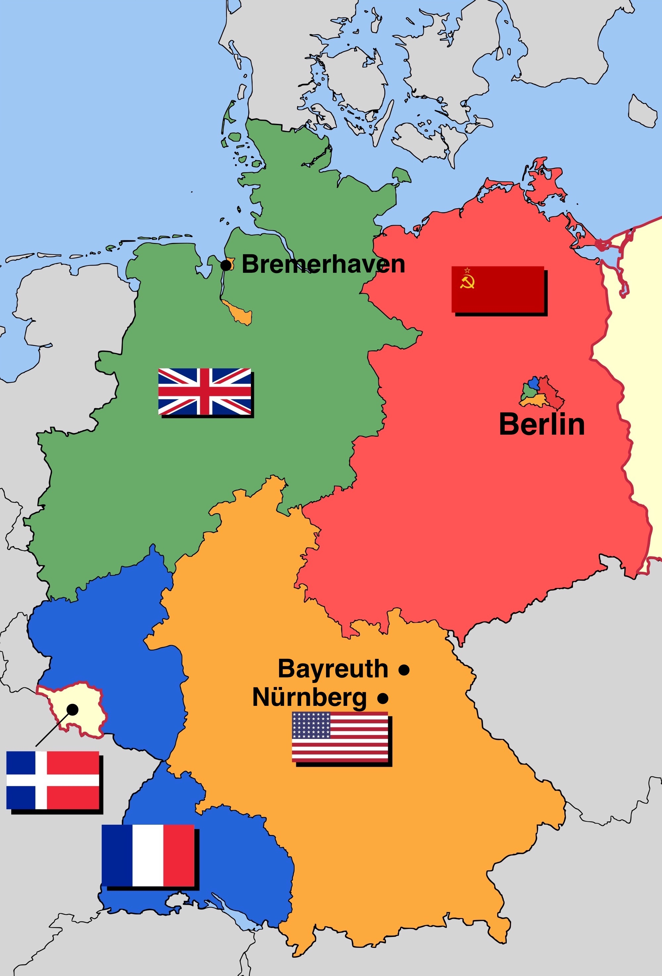
01
Division of Germany

Slide 3
BUT WHY GIVE BERLIN?
War not over
Stalin wanted asia
Thought that It would be temporary

Slide 4
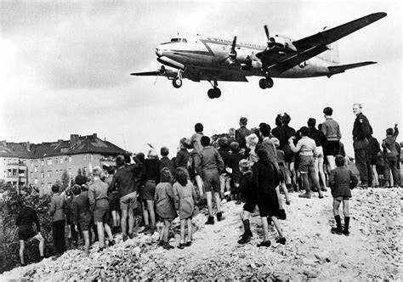
Realization hits
Blockade
Berlin Airlift (max 170,000 tonnes)
Failure

Slide 5



AFTERMATH
Federal Republic of Germany
1949 May
German Democratic Republic
1949 October
North Atlantic Treaty Organization
1949 APRIL

Slide 6
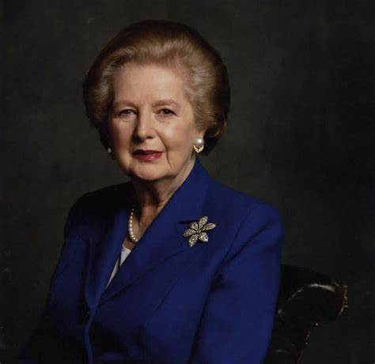



Opposition to german reunification
UK
No
France
There is a price
The Netherlands + Italy
Uh

Slide 7
—Giulio Andreotti
“I love Germany so much that I prefer to see two of them”

Slide 8
THANKS for your attention!

